Slide 1

EMPLOYEE MANAGEMENT SYSTEM
PRESENTED BY : BODDU SIDDHARTHA BATCH NO : 433

Slide 2
ABOUT ME
I am Boddu Siddhartha, a B. Tech (2025) graduate in Computer Science and Engineering from Swami Vivekananda Institute of Technology.
Actively focused on and have a strong interest in using data analytics, SQL-based approaches, and statistical methods to transform raw data into actionable insights that support business decisions.
Enjoy analyzing data, identifying patterns, and applying analytical thinking to real-world business problems.
Have fundamentals and hands-on skills in SQL, Python, Pandas, NumPy, Advanced Statistics, Matplotlib, and Seaborn with a focus on data analysis, visualization, and statistical reasoning through practical projects.
As a fresher, bring a curious mindset, strong analytical thinking, and discipline to convert raw data into actionable insights.
Aim to contribute to data-driven decision making and create measurable business impact.
LinkedIn :
GitHub :

Slide 3
AGENDA
Objective of the Project
ER Diagram and schema explanation
Key analysis questions (use cases)
SQL query results with screenshots or summaries
Final business insights and recommendations
Conclusion (Key finding overall)
Q&A Slide
Your Experience/Challenges working on SQL – Data Analysis Project.

Slide 4
INTRODUCTION
Employee Management System (EMS) is a centralized SQL-based solution for managing organizational employee data.
Designed to store and manage employee details, job roles, departments, salaries, qualifications, leaves, and payroll.
Uses a relational database model with primary and foreign keys to maintain structured, well-organized data and accurate relationships between entities.
Cascading constraints ensure data consistency during updates and deletions while enabling efficient retrieval of employee and payroll information.
Eliminates manual record-keeping, data duplication, and inconsistencies across HR operations while reducing operational effort and manual errors.
Supports analytical querying for workforce, compensation, and leave analysis, providing a strong foundation for data-driven HR decision making.

Slide 5
OBJECTIVE OF THE PROJECT
Build an SQL-based system to efficiently manage employee and HR-related data.
Establish clear relational links between employees, departments, job roles, and payroll.
Maintain accurate and consistent data through enforced database constraints.
Enable HR-focused analysis through optimized SQL queries and aggregations.
Measure organizational metrics such as workforce size, salary expenditure, and leave usage.
Deliver actionable outputs that assist HR teams in operational and strategic planning.

Slide 6
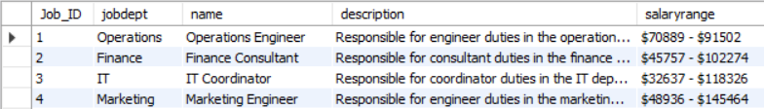
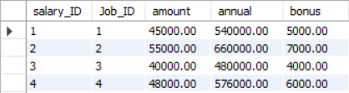
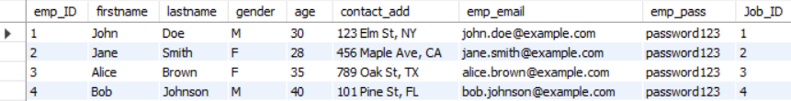
DATABASE SCHEMA OVERVIEW
JobDepartment
SalaryBonus
Employee

Slide 7
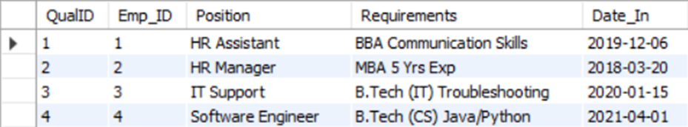
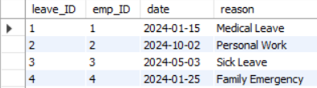
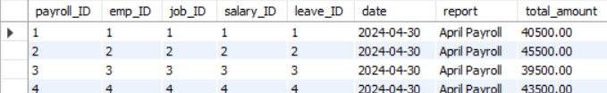
DATABASE SCHEMA OVERVIEW
Qualification
Leaves
Payroll

Slide 8
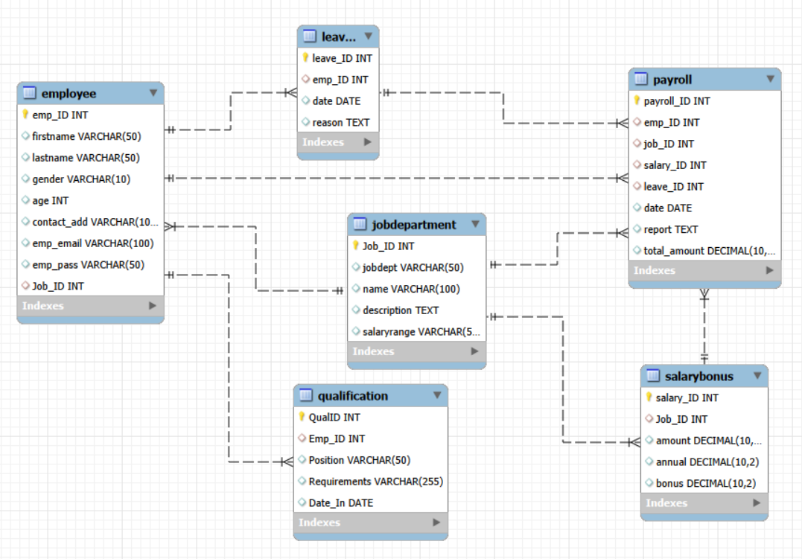
ER Diagram

Slide 9

1. EMPLOYEE INSIGHTS
How many unique employees are currently in the system?
The system manages data for 60 unique employees, forming the organization’s workforce base.

Slide 10
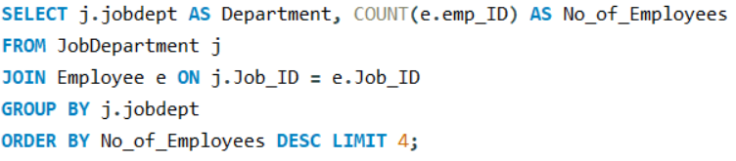
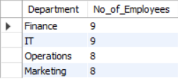
Which departments have the highest number of employees?
Finance and IT departments have the highest employee count, indicating key operational areas.

Slide 11
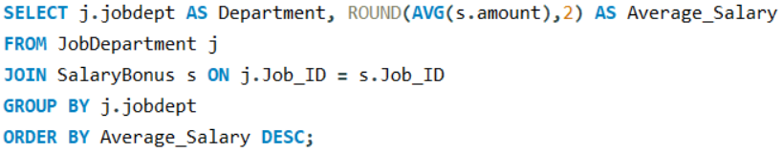
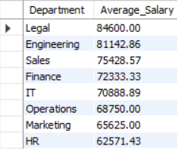
What is the average salary per department?
Salary levels vary by department based on role complexity and skill requirements.

Slide 12
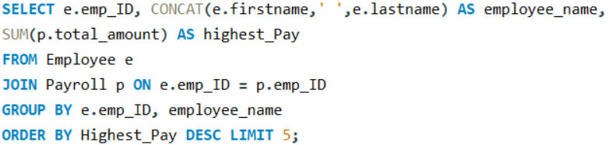
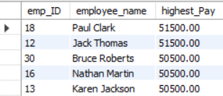
Who are the top 5 highest-paid employees?
The highest-paid employees typically hold senior or high-responsibility positions.

Slide 13


What is the total salary expenditure across the company?
Total salary expenditure highlights payroll as a significant organizational cost.

Slide 14
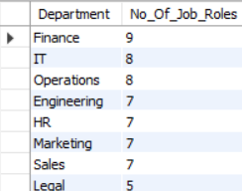
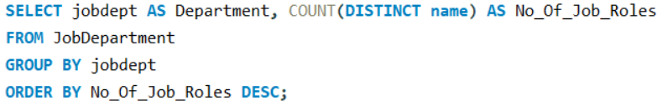
2. JOB ROLE AND DEPARTMENT ANALYSIS
How many different job roles exist in each department?
Departments with more job roles reflect greater functional diversity.

Slide 15
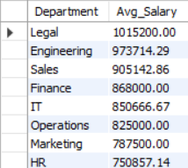
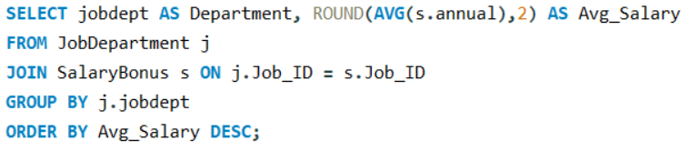
What is the average salary range per department?
Higher average salaries are seen in departments requiring specialized expertise.

Slide 16
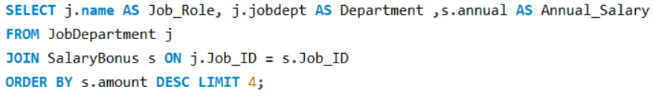
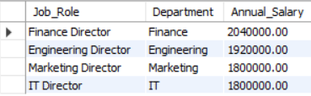
Which job roles offer the highest salary?
Leadership and director-level roles receive the highest compensation.

Slide 17
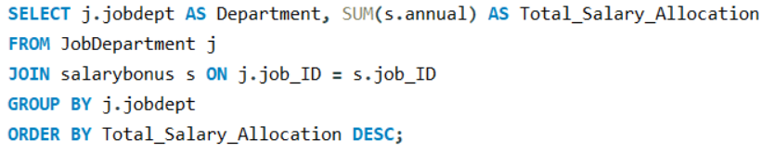

Which departments have the highest total salary allocation?
Salary allocation is highest in departments with both larger teams and higher pay scales.

Slide 18


3. QUALIFICATION AND SKILLS ANALYSIS
How many employees have at least one qualification listed?
Every employee has at least one qualification, showing a fully qualified workforce.

Slide 19
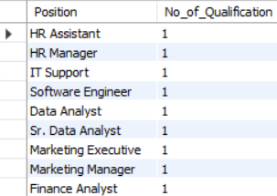

Which positions require the most qualifications?
Technical and analytical roles demand higher qualification requirements.

Slide 20
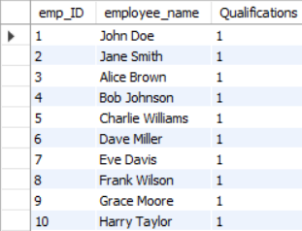
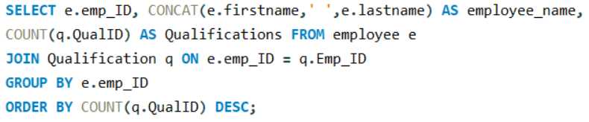
Which employees have the highest number of qualifications?
Employees with multiple qualifications often contribute to critical or growth-focused roles.

Slide 21
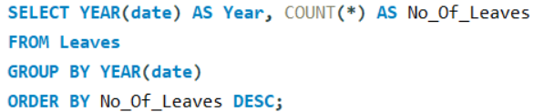

4. LEAVE AND ABSENCE PATTERNS
Which year had the most employees taking leaves?
The year with the highest leave count reflects increased workforce absence during that period.

Slide 22
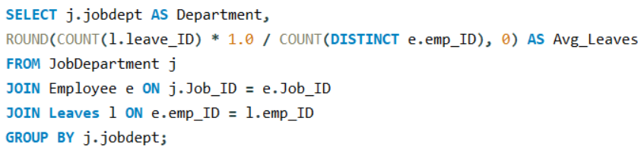
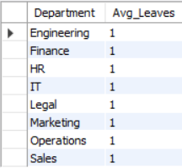
What is the average number of leave days taken by its employees per department?
Similar leave averages across departments indicate uniform leave policies.

Slide 23
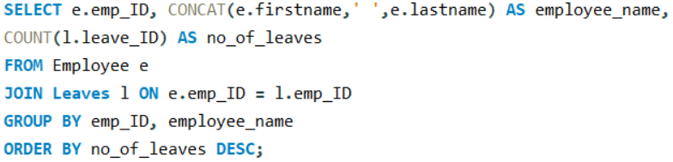
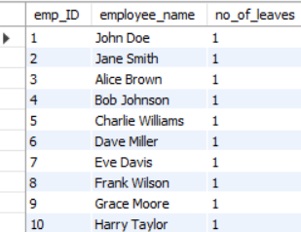
Which employees have taken the most leaves?
Identifying high-leave employees helps HR plan workloads effectively.

Slide 24


What is the total number of leave days taken company-wide?
Total leave days provide an overview of overall employee availability.

Slide 25
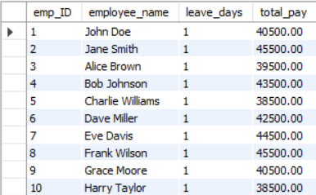
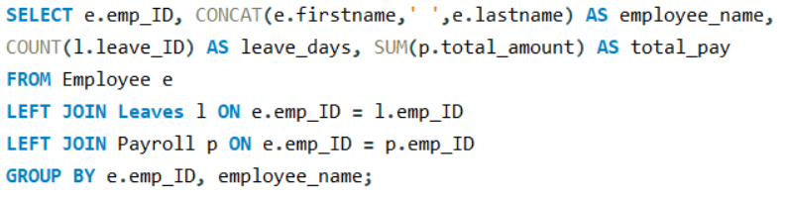
How do leave days correlate with payroll amounts?
Payroll amounts show an indicative relationship with employee leave usage.

Slide 26
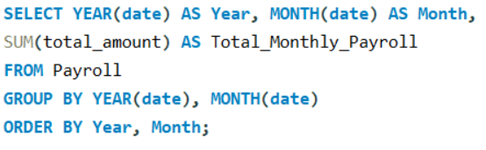

5. PAYROLL AND COMPENSATION ANALYSIS
What is the total monthly payroll processed?
Monthly payroll trends help track consistent compensation flow.

Slide 27
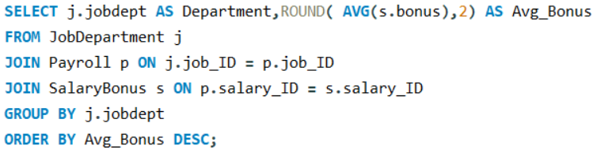
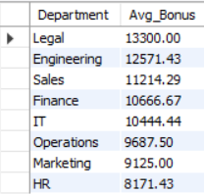
What is the average bonus given per department?
Bonus distribution differs across departments based on performance and role impact.

Slide 28
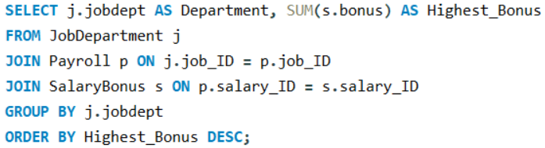
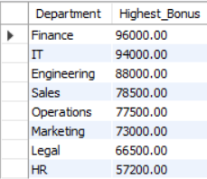
Which department receives the highest total bonuses?
Departments receiving higher bonuses typically support key business outcomes.

Slide 29


What is the average value of total amount after considering leave deductions?
Final payroll values reflect the combined effect of salary, bonuses, and leave deductions.

Slide 30
Business Insights and Recommendations
KEY BUSINESS INSIGHTS
Departments with a higher number of employees contribute the largest share of total payroll expenditure, indicating their critical operational role.
Salary distribution varies significantly across departments, reflecting differences in skill requirements, job complexity, and responsibilities.
High-paying job roles are closely associated with specialized skills and higher qualification levels.
Payroll analysis shows that compensation costs form a major recurring organizational expense, requiring continuous monitoring.
Leave usage patterns are generally balanced across departments, suggesting consistent leave policies within the organization.
Employees with multiple qualifications tend to receive higher compensation, highlighting the business value of skill development and expertise.
BUSINESS RECOMMENDATIONS
Regularly review high-cost departments to ensure optimal workforce utilization and cost-to-performance balance.
Introduce skill-based incentives and certification-linked bonuses to encourage continuous employee upskilling.
Monitor payroll expenditure trends periodically to identify opportunities for cost optimization without affecting productivity.
Use leave pattern analysis to improve workload planning and prevent productivity loss during peak absence periods.
Extend the Employee Management System to include performance tracking and predictive analytics for strategic HR decision-making.

Slide 31
Conclusion
Successfully designed and implemented an SQL-based Employee Management System for structured HR data management.
Integrated employee, department, job role, salary, qualification, leave, and payroll information into a unified database.
Ensured data accuracy, consistency, and integrity using relational database principles and constraints.
Performed comprehensive SQL analysis to extract meaningful workforce and payroll insights.
Analyzed workforce distribution, compensation patterns, and departmental cost trends.
Enabled efficient payroll processing and leave tracking through optimized queries.
Demonstrated the importance of structured data in supporting informed business decisions.
Designed the system to be scalable and adaptable for future HR and analytical enhancements.

Slide 32
CHALLENGES
Designing an appropriate relational database schema and identifying correct relationships between multiple tables.
Implementing foreign key constraints and cascading rules without causing dependency or reference errors.
Managing data consistency while integrating employee, payroll, leave, and salary information.
Writing complex SQL queries involving multiple joins, aggregations, and grouping operations.
Handling real-world scenarios such as multiple payroll records, leave aggregation, and department-level analysis.
Interpreting query results and converting technical outputs into meaningful business insights.

Slide 33

THANK YOU

